Slide 1
Microsoft Power Platform + Dynamics 365
Notes:
Hi, Welcome to Microsoft Power Platform + Dynamics 365 Bootcamp.

Slide 2


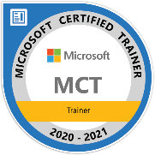
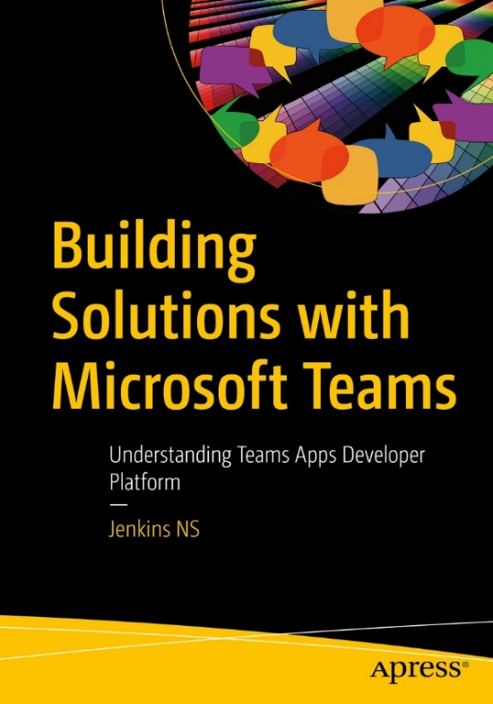








Jenkins NS
Modern Workplace Solution Architect | Consultant
17+ Years of experience
Power Platform, Microsoft Teams, and SPFx Specialist
International Speaker | Author | Trainer
SPS/M365 Bangalore Organizer
aOS Ambassador
jenkinsns@gmail.com
in/jenkinsns
@jenkinsns
http://www.jenkinsblogs.com
https://www.youtube.com/user/jenkinsns

Slide 3
Course Overview
Day 1 – Part I
Empowering Everyone with Power Platform – From CEO to Frontline Workers
Introduction to Power Platform
Day 1 – Part II
Power Packed Day with Power Canvas Apps
Introduction to PowerApps
Day 2– Part I
Power Packed Day with Power Model Driven Apps
Let’s talk about data
Day 2– Part II
Power Packed Day with Power Automate
Introduction
Day 3– Part I
Power Packed Day with Power Agents
Introduction
Microsoft Power Platform momentum
Why Power Platform?
Customer Stories
Demo
Benefits of PowerApps
What can I build with PowerApps?
Types of PowerApps
Canvas Apps
Data Sources and Connectors
Demo
Types of Data
Common Data Service
Model-driven Apps
What type of components can I add?
Data model design
Demo
Types of flow
Data types and expression
Working with Arrays
Control flow and action settings
Demo
A Robust Virtual Agent Platform
Converse everywhere
Easily make your bots better
Create personalized customer experiences
Transfer to a human agent
Built on Power Platform & Azure Bot Service
Extend your bot capabilities with Azure Bot Service
Demo

Slide 4
Continue…
Day 3 – Part II
Power Packed Day with Power BI
Introduction
Day 4– Part I
Power up your Apps with AI Builder
Introduction
Day 4– Part II
Power Platform Administration, Security & Integration Connectors
Introduction
Day 5– Part I
Power Packed Bizz Apps Day – Sales & Marketing
Introduction
Day 5– Part II
Power Packed Bizz Apps Day– Finance & Supply Chain
Introduction
AI for every app. And everyone
Setup Environment
Types of AI Model
Prediction
Form processing
Object detection
Text classification
Demo
The 5x5 Principle
Customer momentum: Power BI
Power BI Desktop
Data sources
Power Query
Dataflow
Using a Calculation (DAX) in multiple files
Paginated Reporting
Power BI Admin Portal
Demo
Secure your tenant
Monitor your tenant’s activity
Alert & act on that activity
Connectors
SharePoint Integration
Demo
Nurture more demand
Personalize buyer experiences
Build relationships at scale
Make insight-driven decisions
Demo
How to embed Power BI in Dynamics 365 for Sales and Marketing
Technology Modernization
Modern Finance
Supporting modern supply chain management
Demo
How to embed Power Platform in Dynamics 365 for Finance and Supply Chain

Slide 5
Day 1: Empowering Everyone with Power Platform
From CEO to Frontline Workers – Part I

Slide 6

Agenda
Introduction to Power Platform
Microsoft Power Platform momentum
Why Power Platform?
Customer Stories
Demo
Create a canvas app from scratch based on Excel data

Slide 7
Notes:
Microsoft is building the world’s most comprehensive connected business cloud.
Microsoft uniquely positioned to do that by leveraging the power of unified data and applied intelligence.
Why? Why is this important?
It’s because of our customers.
It’s important because our customers need four things to accelerate their business success

Slide 8












Innovate across industry
Industries are being disrupted. Transform to disrupt yours.
Consumer goods
Education
Non-profit
Healthcare
Professional services
Central government
Education
Non-profit
Healthcare
Financial services
Travel
Technology
Insurance
Utilities
Transportation
Technology
Utilities
Transportation
Public sector
Retail
Banking
Energy
Local government
Manufacturing
Public sector
Retail
Banking
Manufacturing

Slide 9








Optimize across organizations
From startups to multinational corporations
Education
Non-profit
Healthcare
Utilities
Transportation
Public sector
Retail
Banking
Technology
Manufacturing

Slide 10

Reactive action
Proactive action
Siloed view
Connected view
Incomplete data
Holistic data
Reporting activity
Delivering outcomes
Notes:
Instead of reacting to what happened, customers need to take proactive action based on insights
Instead of looking at their business in parts, they need to access a holistic view of their entire business, from marketing to sales to back-office operations and more
Instead of making decisions based on incomplete information, they need to draw on every connected data source to help predict the next best action
Instead of focusing on reporting activity that happened in the past, they need to pursue meaningful business goals and outcomes for the future
These are the attributes a customer needs to be successful
How?

Slide 11

Notes:
It starts with how they get the most out of their business data
Data is everywhere – generated at every step of our lives
90% of world’s data generated in last 3 years alone
Everything we do, everything our customers do, everything competitors do generates some kind of data
T: In the old world, that data lived in siloes

Slide 12

Notes:
The applications that ingest that data, trap that data
When data is trapped, organizations can’t move to a proactive position, they can’t see a holistic view of their business, they can’t make decisions based on all available information
T: How do we free organizations from the data silos that plague them?

Slide 13
Transform
products
Optimize
operations
Data & AI
Engage
customers
Empower
people
Notes:
That has been at the core of our strategy for Microsoft’s business applications
For organizations to be successful, they need to digitally connect every asset of their business – optimizing operations, empowering people, engaging customers, and transforming products
To help customers accelerate their businesses, we needed to create a set of solutions that unified their data and delivered applied, inherent intelligence right within the solution
T: That what we’ve done with Dynamics 365 and the Power Platform

Slide 14
The world’s connected AI business cloud
Sales
Marketing
Talent
Service
Finance
Commerce
Operations
Dynamics 365 & Power Platform
Notes:
With connected data and applied intelligence at the core, Dynamics 365 and Power Platform form the basis of the most comprehensive set of connected, intelligent business applications in the world today
From sales, to finance, to talent management and more, customers need a deep understanding of their business in order to succeed – not just in one department, but across everything
With Dynamics 365, we have the unique ability to bring together data from virtually any source, whether it’s a Microsoft system or not and bring it into this connected digital feedback loop
Built on hyperscale cloud platform with Azure, with inherent intelligence at app layer
Allowing everyone to analyze, act, automate with Power Platform
T: To do this, we need a multifaceted set of solutions

Slide 15
The world’s connected AI business cloud
Intelligent Sales & Marketing
Proactive Customer Service
Connected Field Service
Modern Finance & Operations
Connected Commerce
Dynamics 365 Sales | Dynamics 365 Customer Service | Dynamics 365 Field Service | Dynamics 365 Finance | Dynamics 365 Commerce
Dynamics 365 Marketing | Dynamics 365 Field Service | Dynamics 365 Marketing | Dynamics 365 Supply Chain Management | Dynamics 365 Marketing
 | Dynamics 365 Marketing | Dynamics 365 Customer Service | Dynamics 365 Business Central
 |  |  | Dynamics 365 Talent
Dynamics 365 Customer Insights | Dynamics 365 Customer Insights | Dynamics 365 Customer Insights | Dynamics 365 Fraud Protection | Dynamics 365 Connected Store
Dynamics 365 Sales Insights | Dynamics 365 Customer Service Insights | Forms Pro |  | Dynamics 365 Fraud Protection
Dynamics 365 Market Insights | Dynamics 365 Virtual Agent for Customer Service |  |  | Dynamics 365 Customer Insights
LinkedIn Sales Navigator | Dynamics 365 Product Insights
Forms Pro | Forms Pro
Dynamics 365 Product Visualize | Dynamics 365 Guides | Dynamics 365 Remote Assist | Dynamics 365 Guides | Dynamics 365 Layout
 |  | Dynamics 365 Guides | Dynamics 365 Layout
Transactional
Notes:
It starts with transactional data
Creating best-in-class apps with infused intelligent capabilities

Slide 16
The world’s connected AI business cloud
Intelligent Sales & Marketing
Proactive Customer Service
Connected Field Service
Modern Finance & Operations
Connected Commerce
Dynamics 365 Sales | Dynamics 365 Customer Service | Dynamics 365 Field Service | Dynamics 365 Finance | Dynamics 365 Commerce
Dynamics 365 Marketing | Dynamics 365 Field Service | Dynamics 365 Marketing | Dynamics 365 Supply Chain Management | Dynamics 365 Marketing
 | Dynamics 365 Marketing | Dynamics 365 Customer Service | Dynamics 365 Business Central
 |  |  | Dynamics 365 Talent
Dynamics 365 Customer Insights | Dynamics 365 Customer Insights | Dynamics 365 Customer Insights | Dynamics 365 Fraud Protection | Dynamics 365 Connected Store
Dynamics 365 Sales Insights | Dynamics 365 Customer Service Insights | Forms Pro |  | Dynamics 365 Fraud Protection
Dynamics 365 Market Insights | Dynamics 365 Virtual Agent for Customer Service |  |  | Dynamics 365 Customer Insights
LinkedIn Sales Navigator | Dynamics 365 Product Insights
Forms Pro | Forms Pro
Dynamics 365 Product Visualize | Dynamics 365 Guides | Dynamics 365 Remote Assist | Dynamics 365 Guides | Dynamics 365 Layout
 |  | Dynamics 365 Guides | Dynamics 365 Layout
Analytical
Notes:
That’s what we’ve done with Dynamics 365 Sales, Marketing, Customer Service, etc
Needed to bring in analytical data – the surrounding data not tied to a particular transaction
In 2018, we announced our first insights applications drawing on analytical data – generating insights from any transactional system of record
Intelligent solutions providing actionable insight
We didn’t stop with the analytical layer

Slide 17
The world’s connected AI business cloud
Intelligent Sales & Marketing
Proactive Customer Service
Connected Field Service
Modern Finance & Operations
Connected Commerce
Dynamics 365 Sales | Dynamics 365 Customer Service | Dynamics 365 Field Service | Dynamics 365 Finance | Dynamics 365 Commerce
Dynamics 365 Marketing | Dynamics 365 Field Service | Dynamics 365 Marketing | Dynamics 365 Supply Chain Management | Dynamics 365 Marketing
 | Dynamics 365 Marketing | Dynamics 365 Customer Service | Dynamics 365 Business Central
 |  |  | Dynamics 365 Talent
Dynamics 365 Customer Insights | Dynamics 365 Customer Insights | Dynamics 365 Customer Insights | Dynamics 365 Fraud Protection | Dynamics 365 Connected Store
Dynamics 365 Sales Insights | Dynamics 365 Customer Service Insights | Forms Pro |  | Dynamics 365 Fraud Protection
Dynamics 365 Market Insights | Dynamics 365 Virtual Agent for Customer Service |  |  | Dynamics 365 Customer Insights
LinkedIn Sales Navigator | Dynamics 365 Product Insights
Forms Pro | Forms Pro
Dynamics 365 Product Visualize | Dynamics 365 Guides | Dynamics 365 Remote Assist | Dynamics 365 Guides | Dynamics 365 Layout
 |  | Dynamics 365 Guides | Dynamics 365 Layout
Observational
Notes:
Solutions to add insight to core business functions and increase organization’s ability to move from reactive to proactive position
We also know that modern solutions interact with real world
Brought in observational data generated by users interacting with, acting on, and gathering data from the physical world around them

Slide 18
The world’s connected AI business cloud
Intelligent Sales & Marketing
Proactive Customer Service
Connected Field Service
Modern Finance & Operations
Connected Commerce
Dynamics 365 Sales | Dynamics 365 Customer Service | Dynamics 365 Field Service | Dynamics 365 Finance | Dynamics 365 Commerce
Dynamics 365 Marketing | Dynamics 365 Field Service | Dynamics 365 Marketing | Dynamics 365 Supply Chain Management | Dynamics 365 Marketing
 | Dynamics 365 Marketing | Dynamics 365 Customer Service | Dynamics 365 Business Central
 |  |  | Dynamics 365 Talent
Dynamics 365 Customer Insights | Dynamics 365 Customer Insights | Dynamics 365 Customer Insights | Dynamics 365 Fraud Protection | Dynamics 365 Connected Store
Dynamics 365 Sales Insights | Dynamics 365 Customer Service Insights | Forms Pro |  | Dynamics 365 Fraud Protection
Dynamics 365 Market Insights | Dynamics 365 Virtual Agent for Customer Service |  |  | Dynamics 365 Customer Insights
LinkedIn Sales Navigator | Dynamics 365 Product Insights
Forms Pro | Forms Pro
Dynamics 365 Product Visualize | Dynamics 365 Guides | Dynamics 365 Remote Assist | Dynamics 365 Guides | Dynamics 365 Layout
 |  | Dynamics 365 Guides | Dynamics 365 Layout
Notes:
We talked about our first mixed reality apps in 2018, and we’ve continued to innovate since then

Slide 19
The world’s connected AI business cloud
Intelligent Sales & Marketing
Proactive Customer Service
Connected Field Service
Modern Finance & Operations
Connected Commerce
Dynamics 365 Sales | Dynamics 365 Customer Service | Dynamics 365 Field Service | Dynamics 365 Finance | Dynamics 365 Commerce
Dynamics 365 Marketing | Dynamics 365 Field Service | Dynamics 365 Marketing | Dynamics 365 Supply Chain Management | Dynamics 365 Marketing
Dynamics 365 Customer Insights | Dynamics 365 Marketing | Dynamics 365 Customer Service | Dynamics 365 Business Central | Dynamics 365 Connected Store
Dynamics 365 Sales Insights | Dynamics 365 Customer Insights | Dynamics 365 Customer Insights | Dynamics 365 Talent | Dynamics 365 Fraud Protection
Dynamics 365 Market Insights | Dynamics 365 Customer Service Insights | Forms Pro | Dynamics 365 Fraud Protection | Dynamics 365 Customer Insights
LinkedIn Sales Navigator | Dynamics 365 Virtual Agent for Customer Service | Dynamics 365 Remote Assist | Dynamics 365 Guides | Dynamics 365 Layout
Forms Pro | Dynamics 365 Product Insights | Dynamics 365 Guides | Dynamics 365 Layout
Dynamics 365 Product Visualize | Forms Pro
 | Dynamics 365 Guides
Power Platform | Power BI | Power Apps | Power Automate | Power Virtual Agents | AI Builder | Portals
Notes:
With Power Platform, we’re empowering everyone to analyze, act, and automate
With Power BI, PowerApps, and Power Automate, along with capabilities like AI Builder and Portals, we’re empowering every individual in an organization to engage with all of those data types to create custom solutions for their business needs
This is the connected AI business cloud
Bringing together the complete portfolio of Dynamics 365 and Power Platform
Unifying all forms of data with infused, applied intelligence

Slide 20



Microsoft Power Platform
The low-code platform that spans Office 365, Azure, Dynamics 365, and standalone applications
Innovation anywhere. Unlocks value everywhere.
Power BI
Business analytics
Power Apps
Application development
Power Automate
Process automation
Power Virtual Agents
Intelligent virtual agents
Data connectors
Portals
AI Builder
Common Data Service

Slide 21
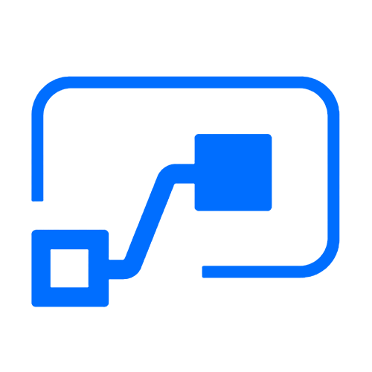



Who here has a Microsoft 365 background?
SharePoint, Teams, Exchange…
Microsoft 365
Analyze
Act
Automate
Data connectors
Power BI
Business analytics
Power Apps
Low-code/no-code application development
Power Automate
Workflow automation
Standalone apps
Common Data
Service
AI Builder

Slide 22
What about a Dynamics 365 background?
Sales, Service, Talent…
Microsoft 365
Dynamics 365
Analyze
Act
Automate
Data connectors
Power BI
Business analytics
Power Apps
Low-code/no-code application development
Power Automate
Workflow automation
Standalone apps
Common Data
Service
AI Builder

Slide 23
Last, but not least, what about Azure?
Azure SQL, Azure Functions…
Microsoft 365
Dynamics 365
Microsoft Azure
Analyze
Act
Automate
Data connectors
Power BI
Business analytics
Power Apps
Low-code/no-code application development
Power Automate
Workflow automation
Standalone apps
Common Data
Service
AI Builder

Slide 24
Why Power Platform?
Time
Resources
Cost
Data
Maintenance

Slide 25
Low Code Evolution

Slide 26

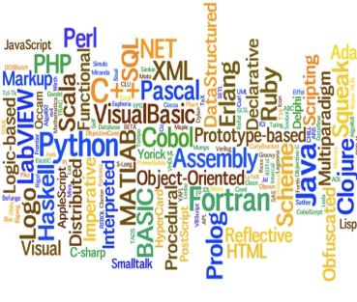


The evolution of how people buy applications
Custom Software
Packaged Software
Low-code Development
What development language do you use?
How feature rich is your software?
How agile and extensible is your platform?
ERP
CRM
HRM
ERP
CRM
HRM
Middle
-ware
MRP
Middle
-ware
PRM
MRP
PRM
MRP
OPS
LOG.
…
OPS
PRM
…

Slide 27
Benefits of low-code development platforms
Environment used to create web or mobile applications easily by mostly configurations, drop-and drops.
LOW-CODE
DEVELOPMENT PLATFORMS
Higher rate of success
Loved by both Business & IT
Breeds Innovations
Days to Weeks
Success Rate
Time to Live
Business Relevance
Innovative Culture
Traditional computer programming, writing lines of codes from scratch.
Failed projects are common
Lagging IT & constant tension with business
TRADITIONAL
DEVELOPMENT
Months to Years
Curbs Innovation

Slide 28
Continue… Part 2

